Slide 1
Comparison between characters in Animal Farm and real life people
By Kurt Burgess

Slide 2
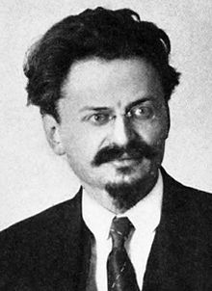
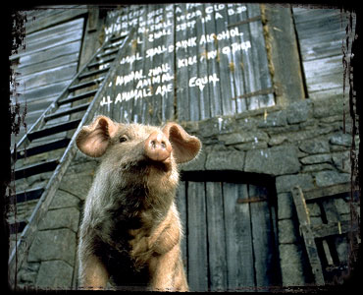
Leon Trotsky is Snowball

Slide 3
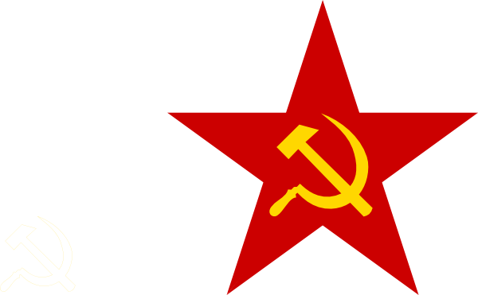

What I have found:
Leon Trotsky:
He was a leader at the start of the communist upraise.
He helped to manage and lead the October Revolution.
He had to escape Russia as he was being persecuted by Stalin and the secret police so Stalin could take full control, and later executed in Mexico by a Mexican communist.
Snowball:
He was a leader at the animalism upraise.
He helped to manage and lead the battle of the Cow shed.
He had to escape the farm after Napoleon (Meant to symbolise Joseph Stalin) and the dogs (Meant to symbolise the secret police) tried to kill him and blamed him for everything that went wrong.

Slide 4
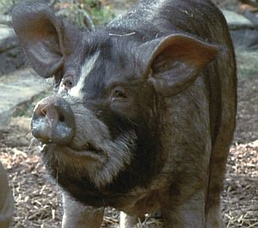
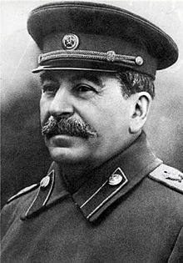
Joseph Stalin is Napoleon

Slide 5
What I have found:
Joseph Stalin:
He is one of the two leaders of Russia
He made the 5 year plan for the industrial development
He uses his secret police to get rid of anyone who does not agree with him.
Napoleon:
He is one of the two leaders of Animal Farm
He made the 3 year plan for the windmill.
He uses the dogs (the secret police) to kill anyone who does not agree with him.

Slide 6
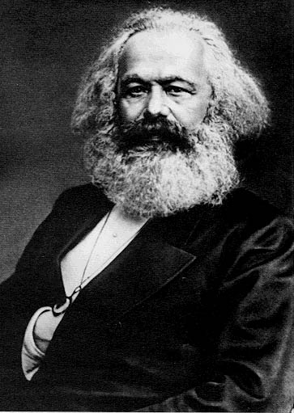
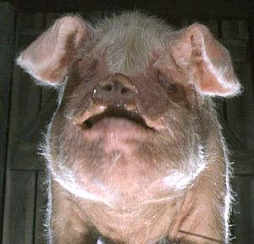
Karl Marx is Old Major

Slide 7
What I have found:
Karl Marx:
He is
Old Major:
He is

